Slide 1



22AIE498
PROJECT PHASE 1
REVIEW - 1

Slide 2
Project Title:. Lightweight Predictive Modeling of Cardiovascular Risk Through Sleep Behavior Analysis in the Elderly.
Team Number : 47
Team Members :
Name | Roll Number
Anuvind MP | AM.EN.U4AIE22010
R S Harish Kumar | AM.EN.U4AIE22042
Project Guide: Ms. Geetha Lekshmi V Project Coordinator: Dr. Veena G
Date: 18 - 09 - 2025 Branch: S7 CSE-AI (Batch: A)

Slide 3
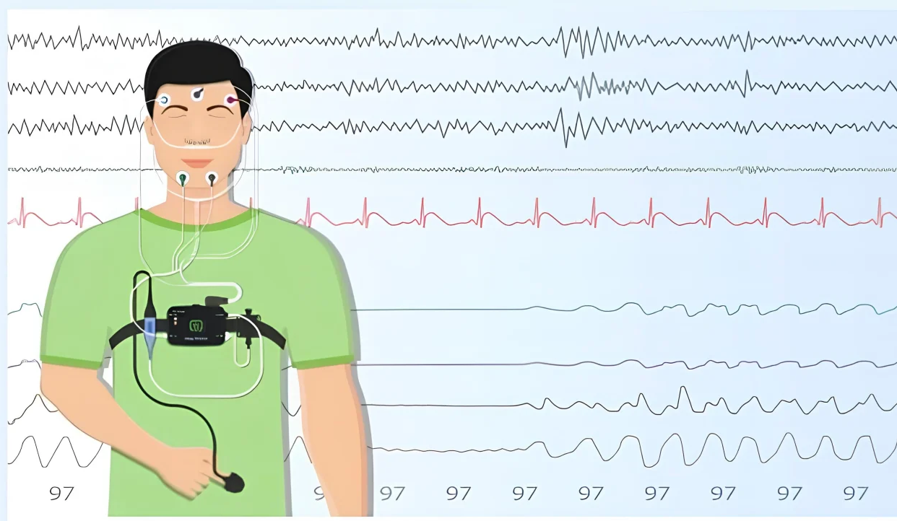
Introduction
Aging populations face increasing chronic disease burdens.
Early detection through sleep analysis facilitates timely interventions.
Increasing healthcare costs and morbidity.
Polysomnography data provides rich insights into cardiovascular disease, neurological conditions (dementia, Parkinson's), diabetes, and mortality risk
This can significantly reduce healthcare costs and improve quality of life for aging adults.
Notes:
Cite the work that detects dementia, Parkinson’s using polysomnography data..
Early detection through sleep analysis facilitates timely interventions – of cardiovascular disease. Dementia ,Parkinson’s???
Introduction should align with disease risk prediction, which are the systems currently using polysomnograpy data and what are the limitations?
Corrections/Modifications
Problem with sleep in elderly?? Statistics
Relation of sleep with cardio vascular disease, any info from papers??give ref also

Slide 4
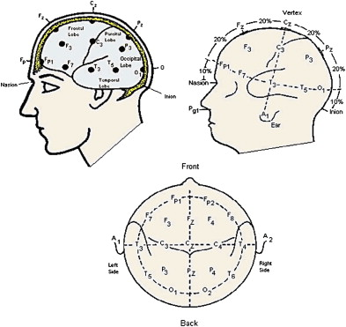

Motivation
The Challenge with Current Approaches :
Current models require extensive labeled data and struggle with missing or heterogeneous sleep data modalities.
High computational demands prevent deployment on resource-constrained edge devices in elderly care facilities.
Poor generalizability across diverse elderly populations limits real-world clinical adoption
Why This Matters :
Sleep data predicts 130+ diseases including cardiovascular, neurological conditions, and mortality risk with high accuracy.
Early detection reduces healthcare costs and improves elderly care outcomes.
Notes:
What is the relevance of this picture in this slide??
Answer the following qtns to fill this slide
What is the relevance of the study?
Cardiovascular disease are prevalent in elderly? Any studies or references?
Is there an existing method of predicting cardiovascular disease from sleep data?
Light weight solutions are essential

Slide 5
Problem Statement
Current multimodal methods lack adaptive modality selection and generalizability across elderly cohorts, hindering scalable personalized risk prediction.
Developing lightweight, self-supervised, edge-deployable models that dynamically handle variable data modalities can transform continuous long-term disease risk monitoring.
Our research aims to develop a lightweight, self-supervised multimodal framework that adaptively fuses PSG data for real-time, edge-deployable disease risk prediction in diverse elderly populations.
Notes:
Objectives of our project
Optimal Feature Selection Algorithm
Light weight Architecture for sleep Analysis – which method is used to design a light weight framework? NAS (RL based, Genetic Algorithm)
Predictive model for heart risk prediction

Slide 6
Literature Review Overview
Ref. No. | Author(s) & Year | Model / Method Used | Limitations & Future Work
[1] | Jiang et al. (2021) | Self-supervised contrastive learning for EEG sleep staging | Computationally expensive; limited interpretability
[2] | Weng et al. (2025) | Systematic SSL survey for EEG: predictive, generative, contrastive approaches | Neglects EEG spatial-temporal nature; unimodal focus
[3] | Lee et al. (2025) | SleepXViT: dual-component ViT with explainability via LRP heatmaps | Needs lightweight model development; dataset expansion
[4] | Kontras et al. (2024) | CoRe-Sleep: multimodal transformer fusion for EEG+EOG | Limited to 2 modalities; single dataset validation
[5] | Thapa et al. (2025) | Multimodal sleep foundation model with 585K hours PSG data | High signal variability; black-box interpretability
[6] | Zhang et al. (2025) | Multiscale transformer with ECG+SpO2 for OSA detection | Regional limitations; high computational cost
[7] | Zhang et al. (2024) | TSEDSleepNet: two-stream encoder-decoder with attention | High complexity (11.3M parameters); limited modalities
[8] | Liu et al. (2025) | MHFNet: hybrid-embedding fusion with gate transformer | Limited to EEG+EOG; computationally expensive

Slide 7
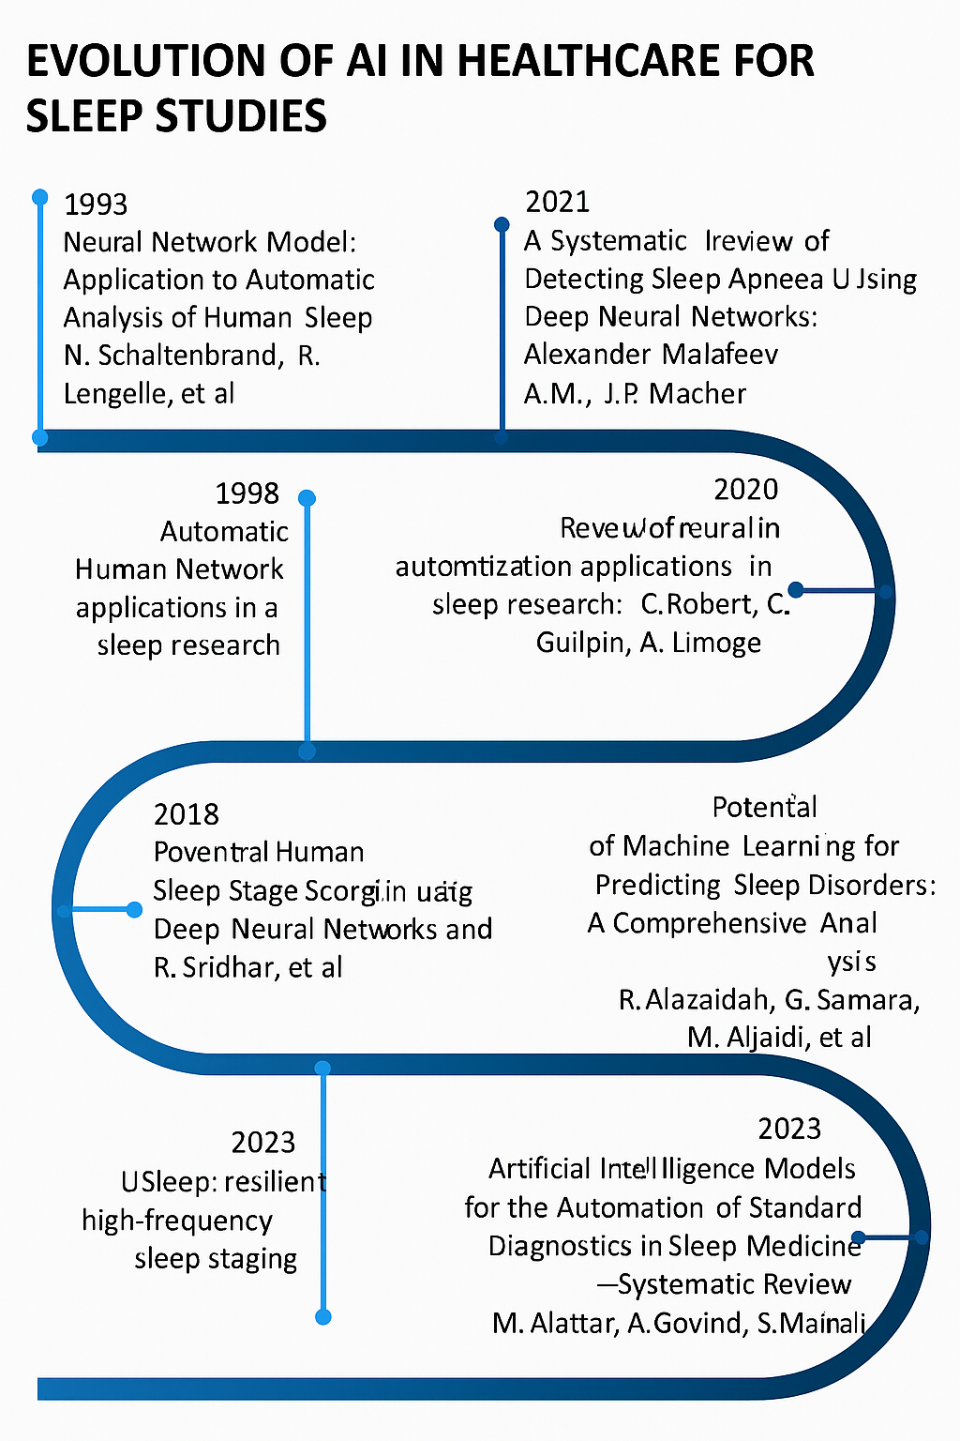
Key Findings from Literature Review
Self-Supervised Learning Shows Promise:
Self-supervised contrastive learning frameworks demonstrate effectiveness for EEG-based sleep analysis, reducing dependency on labeled data.
Foundation models with large-scale PSG data (585K hours) can predict 130+ diseases, showing potential for comprehensive health assessment.
Multimodal Approaches are Limited:
Current multimodal methods are constrained to 2-3 modalities with poor scalability.
Most approaches lack robust handling of missing or noisy modalities in real-world scenarios.
Computational Efficiency Remains a Challenge:
Existing models are computationally expensive (up to 11.3M parameters) and unsuitable for edge deployment.
High complexity models struggle with interpretability, limiting clinical adoption.
Generalization Issues Persist:
Models often validate on single datasets, raising concerns about cross-population generalizability.
Limited validation across diverse elderly cohorts and care settings.
Notes:
What does the picture depict? How it is related to keyfindings from Literature.

Slide 8
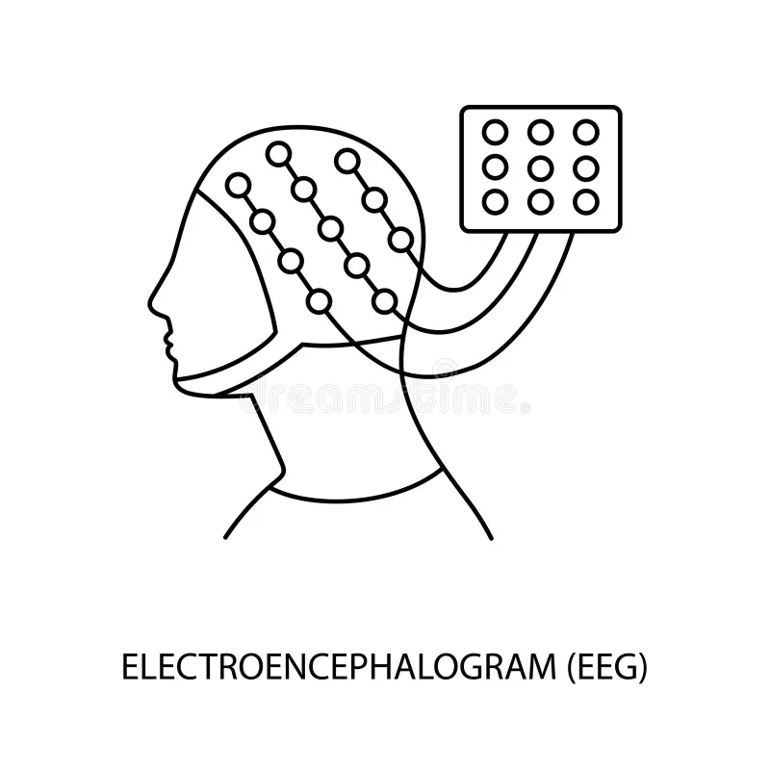
Research Gaps
Most studies add modalities like respiratory and brain activity signals to extract complementary information, but they fail to make the resulting models lightweight or edge-deployable—critical for resource-limited settings such as elderly care homes.
Studies have incorporated channel agnostic multi modal frameworks but not arbitrary and heterogeneous modalities, such fusions technologies are still unexplored.
Many research articles mention health prediction using sleep staging but never a long-term health prediction due to high variance in day-to-day life.
Almost all researches focus on the general population for health mortality predictions but never focus on the elderly where the conditions such as cardio vascular diseases, Parkinson's and Alzheimer's are most prominent.
Notes:
How did you arrive at Gap numbered 2, any refs??
Are we doing longterm health prediction in phase 1? Do we have data for that?

Slide 9
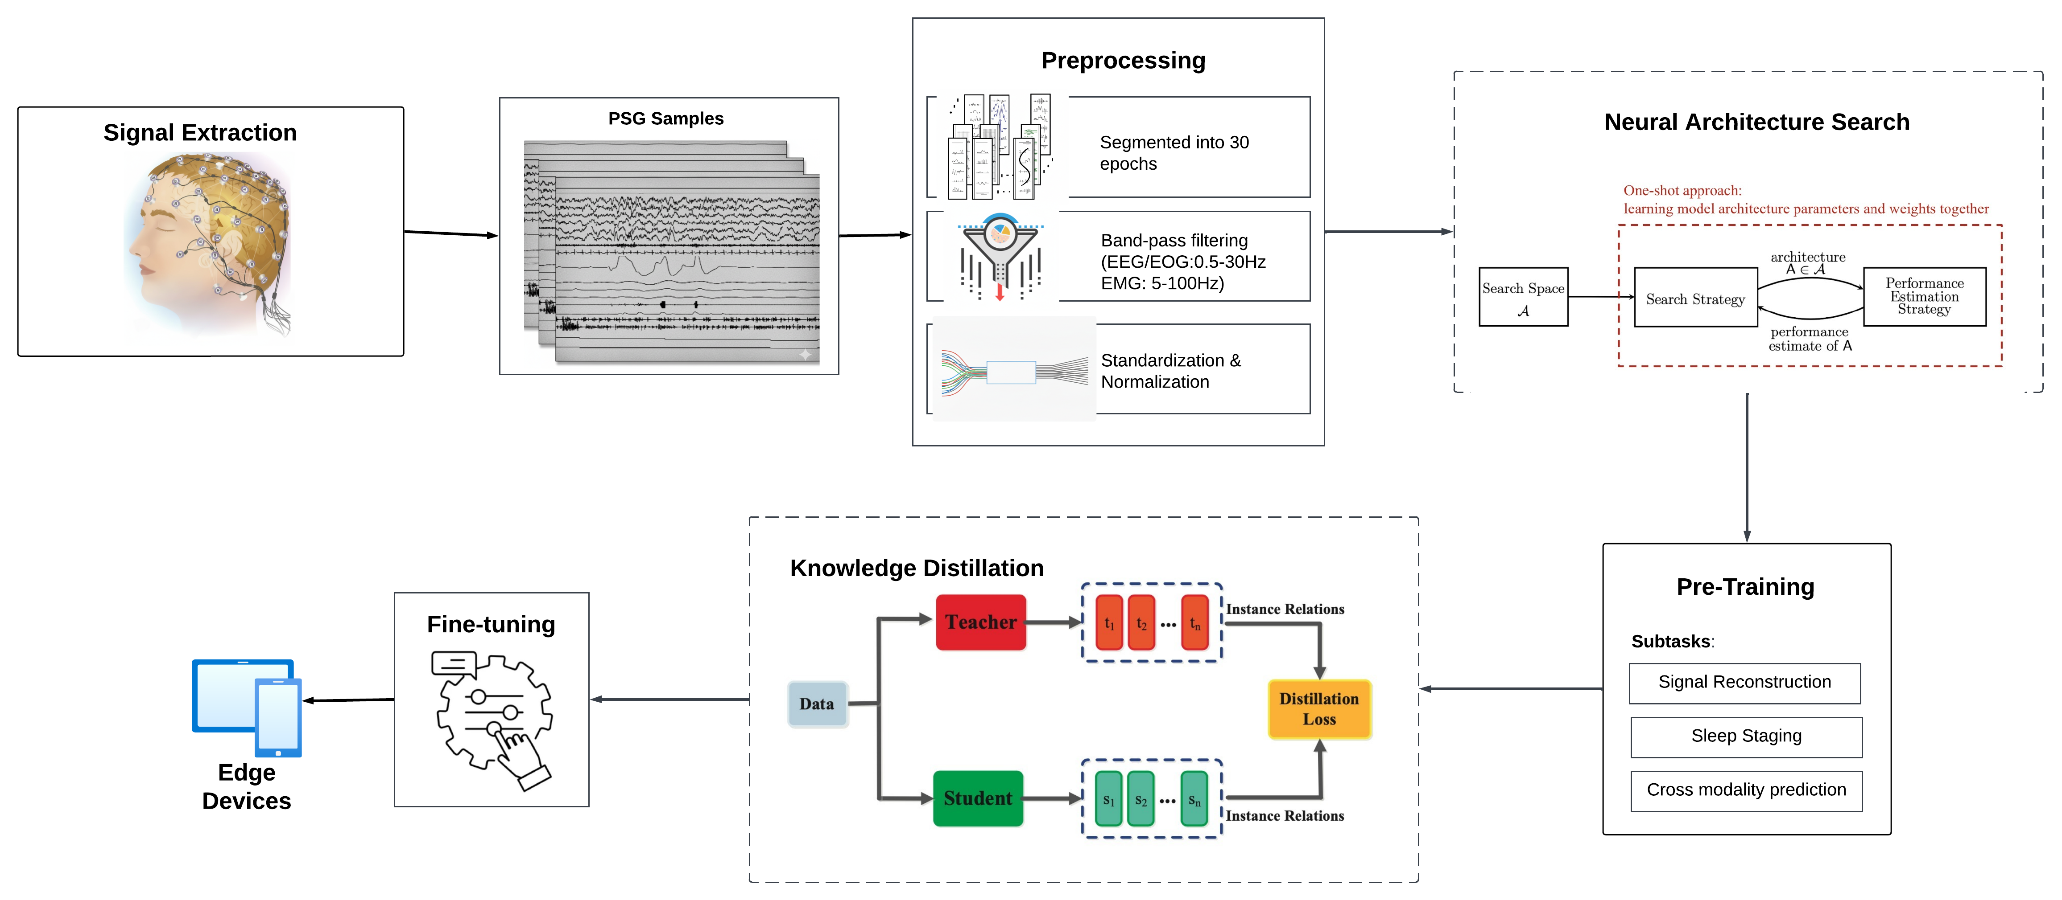
System Architecture (Methodology)
Notes:
Correct the architecture diagram based on the objectives. Accordingly change the modules for phase 1

Slide 10
Methodology – Phase 1 (Part A : Modules)
Preprocessing
This stage transforms raw signals by:
Segmenting them into epochs
Applying band-pass filters to isolate relevant frequencies
Performing standardization and normalization to ensure uniform data scaling for modeling
Knowledge Distillation
Transfers predictive knowledge from a larger, complex teacher model to a smaller student model by:
Minimizing inference cost
Retaining essential information through distillation loss
Pre-Training
A resource-efficient neural network designed to execute subtasks:
Signal Reconstruction
Sleep staging
Cross modality prediction
Fine-tuning
Adapts and optimizes the lightweight model for edge deployment by:
Freezing the layers and adapting the model for the main task.
Tunes the model to now forecast health risks.
Neural Architecture Search (NAS)
Automates the process of discovering optimal model architectures by:
Exploring possible configurations
Evaluating their performance on PSG data
Edge Devices
Hosts the final optimized models, enabling:
Real-time fast inference
Low-resource decision support in clinical or home environments

Slide 11
Methodology – Phase 1 (Part B)
Dataset Selection We collect multimodal polysomnography (PSG) data from diverse sources including Sleep EDFx, SHHS, MROS, MESA, CinC, WSC, and DREEM, ensuring broad coverage of demographics and recording conditions.
Generalization To harmonize heterogeneous datasets, we standardize channel orderings, variable naming conventions, and align recording timelines for consistency across studies.
Preprocessing The raw signals are segmented into 30-second epochs, passed through band-pass filters to isolate relevant frequency bands, resampled to a common 100 Hz rate, and cleaned by excluding corrupted segments. Finally, normalization and standardization are applied to maintain uniform signal scaling.
Architecture Design We experiment with lightweight deep learning architectures—such as MobileNet, EfficientNet, ShuffleNet, SqueezeNet, TinyML approaches, and efficient transformer models—to balance predictive performance with resource efficiency.
Self-Supervised Pretraining (SSL) We incorporate self-supervised tasks including temporal order prediction, cross-modal reconstruction, sleep staging, and apnea detection, which enable the model to learn robust feature representations without requiring extensive labels.

Slide 12


Novelty of the Proposed Work
Design and implementation of a lightweight framework for edge deployability at low-end resource environments.
Propose minimal modality selection for reducing unnecessary data-acquisition and computational overhead without compromising predictive performance.
Produce long-term health forecasting on mainly diseases commonly present in elderly cohorts.
Development mainly focused on elderly risk prediction.

Slide 13
Methodology - (Phase 2)
Minimal Modality Selection We identify the smallest yet most informative subset of modalities to optimize predictive power while reducing computation and sensor overhead.
Model Compression To further enable deployment on edge devices, we apply knowledge distillation techniques to transfer knowledge from large models to compact versions, and use Neural Architecture Search (NAS) to automatically discover efficient structures.
Evaluation and Benchmarking The trained models are rigorously evaluated against standard benchmarks to assess performance, generalizability, and efficiency.
Edge Deployment Finally, the optimized models are deployed on edge devices, ensuring real-time, low-power operation suitable for continuous health monitoring applications.

Slide 14
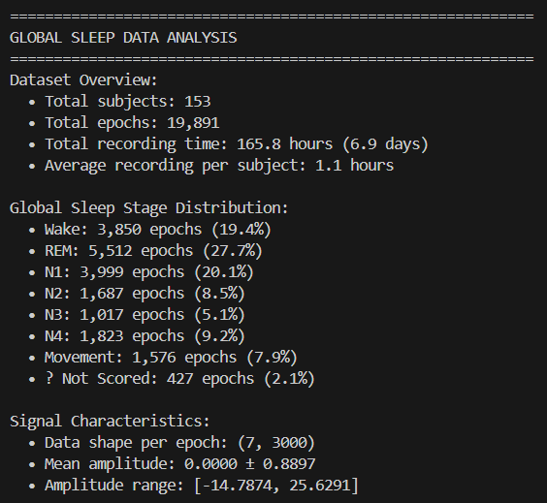
Progress
Sleep – EDF Expanded
Dataset selected: - MESA (342 GB)
- Sleep-EDF Expanded (8.1GB)
Explorative Data Analysis - EDA
• Sleep-EDFx provides 153 patient records out of which only 74 are above age 60 years. • Mesa provides 2237 patient records out of which 1805 records are eligible of the criteria (age>=60) with the mean age being 72.45 years old.
Preprocessing
• Segmented into 30 seconds epoch. • Bandpass filter each channel.
• Resample all to 100Hz.
• Artifact/Bad segment exclusion.
• Normalization/Standardization.
• Map annotation files respectively (W, N1, N2, N3, REM, Movement, ?(Not scored))

Slide 15
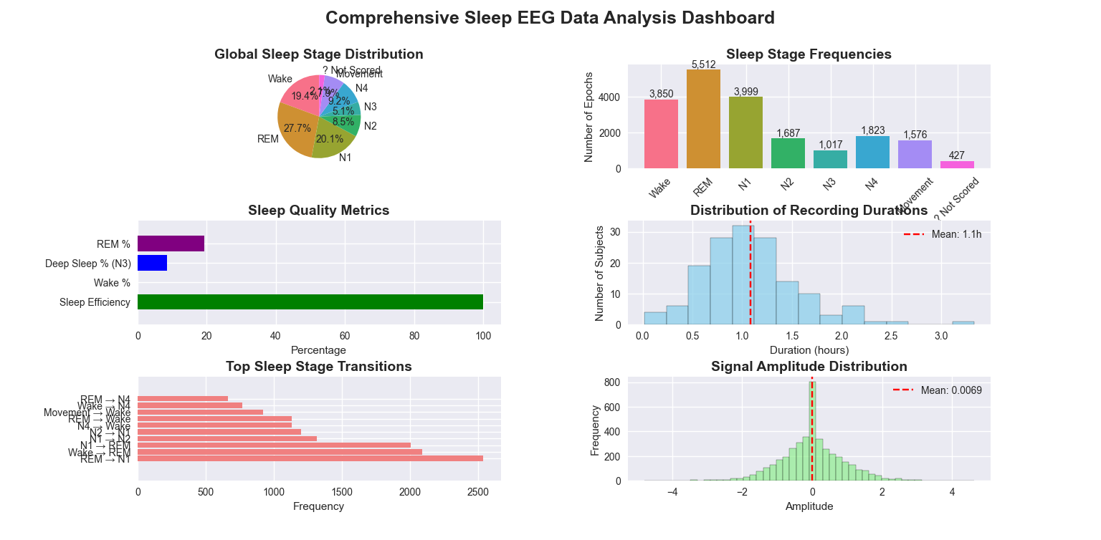

Slide 16

Conclusion
Developed an Edge-deployable model for resource constrained environment such as old age homes.
Reduces inference time and data acquisition by minimal modality selection
Captures Long-term health forecasting using the PSG data.
Integrates Self-Supervised Learning (SSL) leveraging unlabeled data for health prediction for the elderly
Designed a lightweight architecture with model compression techniques such as knowledge distillation and neural architecture search
• Demonstrated cross-cohort generalizability through validation on diverse elderly sleep datasets.
• Achieved real-time, continuous long-term disease risk prediction for scalable personalized monitoring.

Slide 17
REFERENCES
[1] X. Jiang, J. Zhao, B. Du, Z. Yuan, Self-supervised Contrastive Learning for EEG-based Sleep Staging, International Joint Conference on Neural Networks (IJCNN), 2021, pp. 1–8.
[2] W. Weng, Y. Gu, S. Guo, Y. Ma, Z. Yang, Y. Liu, Self-supervised Learning for Electroencephalogram: A Systematic Survey, 2025, pp. 1–15.
[3] H. Lee, Y. R. Choi, H. K. Lee, J. Jeong, J. Hong, H.-W. Shin, H.-S. Kim, Explainable Vision Transformer for Automatic Visual Sleep Staging on Multimodal PSG Signals, 2025, pp. 1–10.
[4] K. Kontras, C. Chatzichristos, H. Phan, J. Suykens, M. De Vos, CoRe-Sleep: A Multimodal Fusion Framework for Time Series Robust to Imperfect Modalities, IEEE Transactions on Neural Systems and Rehabilitation Engineering, 2024, 32(1), pp. 1–12.
[5] R. Thapa, M. R. Kjær, B. He, I. Covert, H. Moore, U. Hanif, G. Ganjoo, B. M. Westover, P. Jennum, A. Brink-Kjær, E. Mignot, J. Zou, A Multimodal Sleep Foundation Model Developed with 500K Hours of Sleep Recordings for Disease Predictions, 2025. doi: https://doi.org/10.1101/2025.02.04.25321675
[6] Y. Zhang, L. Zhou, S. Zhu, Y. Zhou, Z. Wang, L. Ma, Y. Yuan, Y. Xie, X. Niu, Y. Su, H. Liu, X. Hei, Z. Shi, X. Ren, Y. Shi, Deep Learning for Obstructive Sleep Apnea Detection and Severity Assessment: A Multimodal Signals Fusion Multiscale Transformer Model, Nature and Science of Sleep, 2025, 17(1), pp. 1–12.
[7] Z. Zhang, B.-S. Lin, C.-W. Peng, B.-S. Lin, Multi-Modal Sleep Stage Classification with Two-Stream Encoder–Decoder, IEEE Transactions on Neural Systems and Rehabilitation Engineering, 2024, 32(1), pp. 1–11.
[8] R. Liu, J. Li, Y. Wen, X. Huang, B. Sheng, D. D. Feng, P. Zhang, MHFNet: A Multimodal Hybrid-Embedding Fusion Network for Automatic Sleep Staging, IEEE Journal of Biomedical and Health Informatics, 2025, 29(1), pp. 1–9.

Slide 18
THANK YOU !

